Slide 1


WATER QUALITY
ANALYSIS
Roshan.R

Slide 2

INTRODUCTION
Calculating the WQI is time-consuming, but estimating WQI is inevitable for water resources management. For this purpose, three Machine Learning (ML) algorithms, namely, Gene Expression Programming (GEP), M5P Model tree, and Multivariate Adaptive Regression Splines (MARS), were employed to predict WQI.

Slide 3

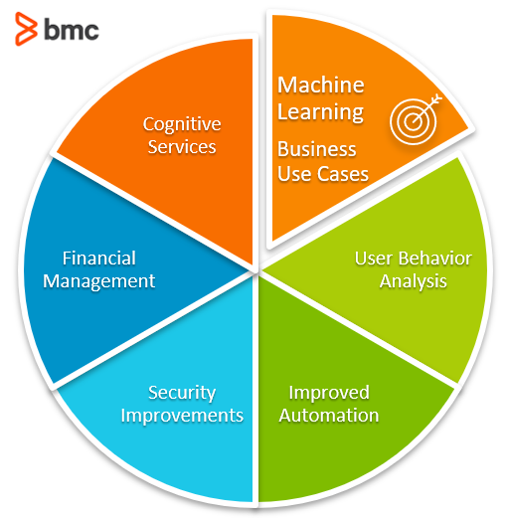
IMPLEMENTATION
Analyzing water quality using MachineLearning (ML) algorithms involvesleveraging computational techniquesto process and interpret water qualitydata, predict parameters, and detectanomalies. Here's a step-by-stepapproach to implementing waterquality analysis using ML algorithms:

Slide 4
Logistic Regressin
MACHINE LEARNING ALGORITHMS:
THAT WE ARE
Going to use
Decision Tree
Random Forest
K-Nearest Neighbours
Suppor Vector Machine

Slide 5




WHOLE DATA SET REQUIRED
Data
Preprocessing:
Feature
Selection:
Model
Training:
Handle missing values,outliers, and anyinconsistencies in thedataset.
Perform feature scaling,normalization, ortransformation as needed.
Identify relevant featuresthat contribute to the waterquality analysis usingtechniques like correlationanalysis, featureimportance, or domainknowledge.
Split the dataset intotraining and testing sets.
Train the selected MLmodels using the trainingset and validate them usingthe testing set.

Slide 6
POTABILITY
OF WATER
Other
39%
Machine Learning project built to practice and improve coding and deployment skills using python, scikit-learn, jupyter-notebooks, and some visualization packages.
Water
61%

Slide 7

Hyperparameter
TUNING Optimize
Optimize modelperformance by tuninghyperparameters usingtechniques like grid searchor random search.

Slide 8
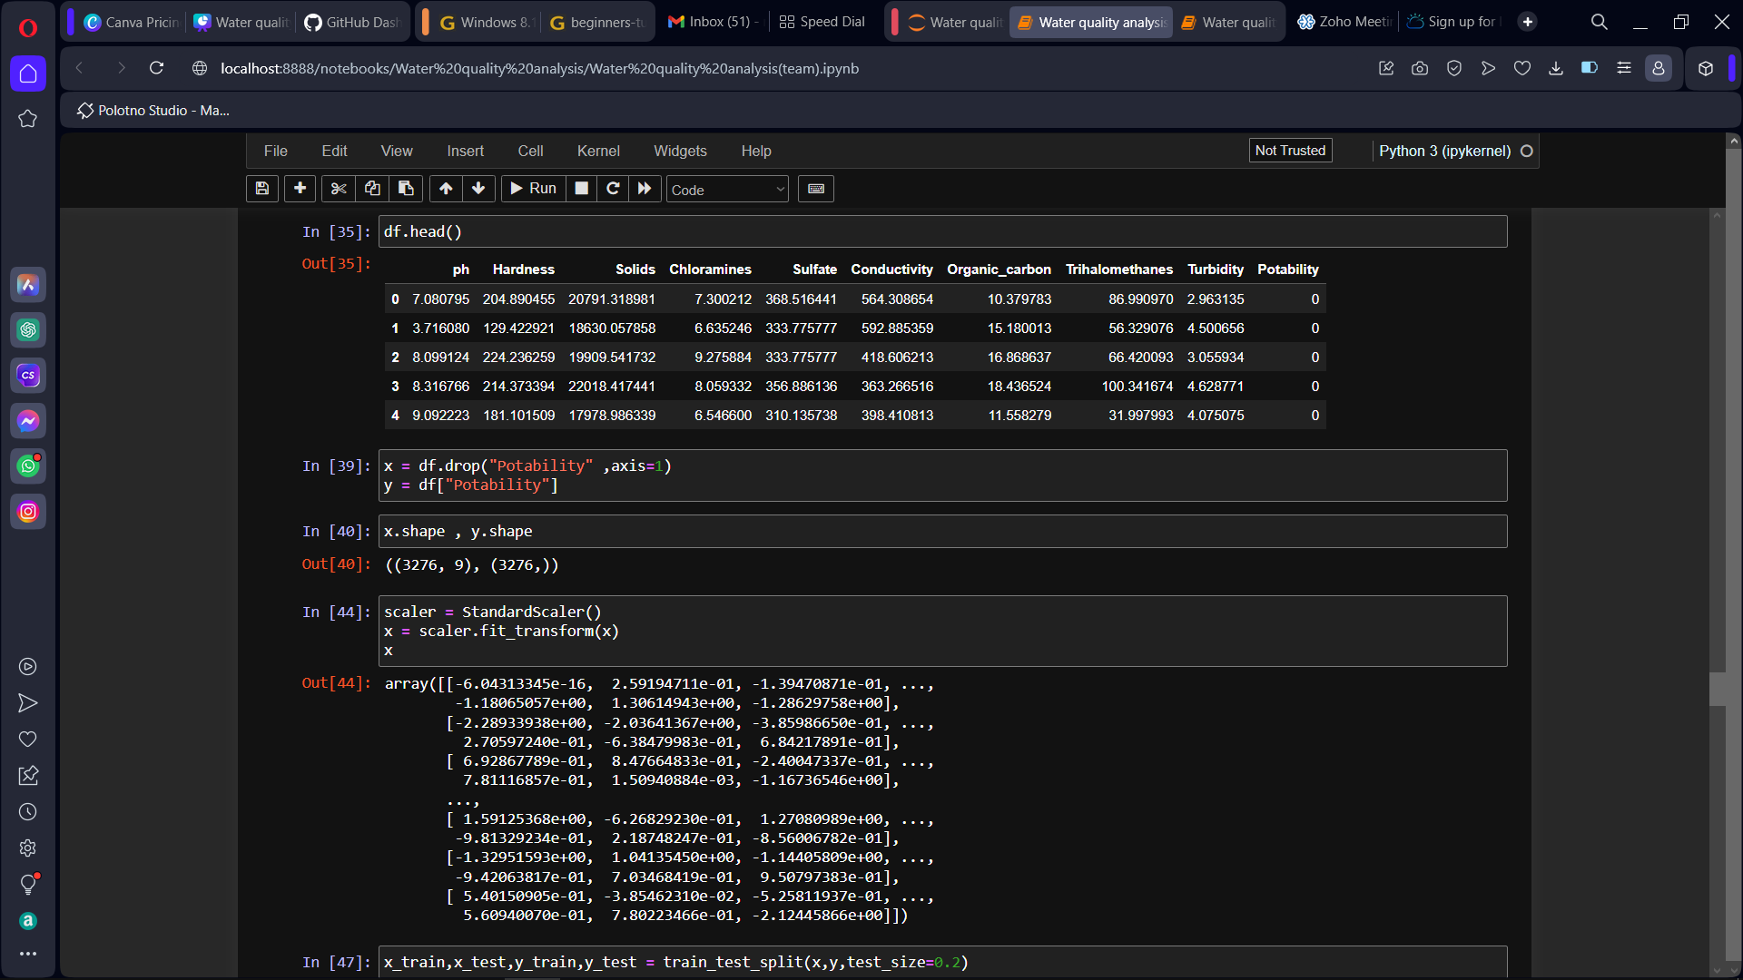
Programs:

Slide 9
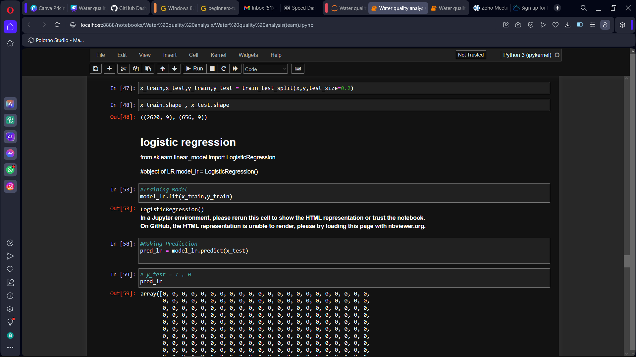

Slide 10
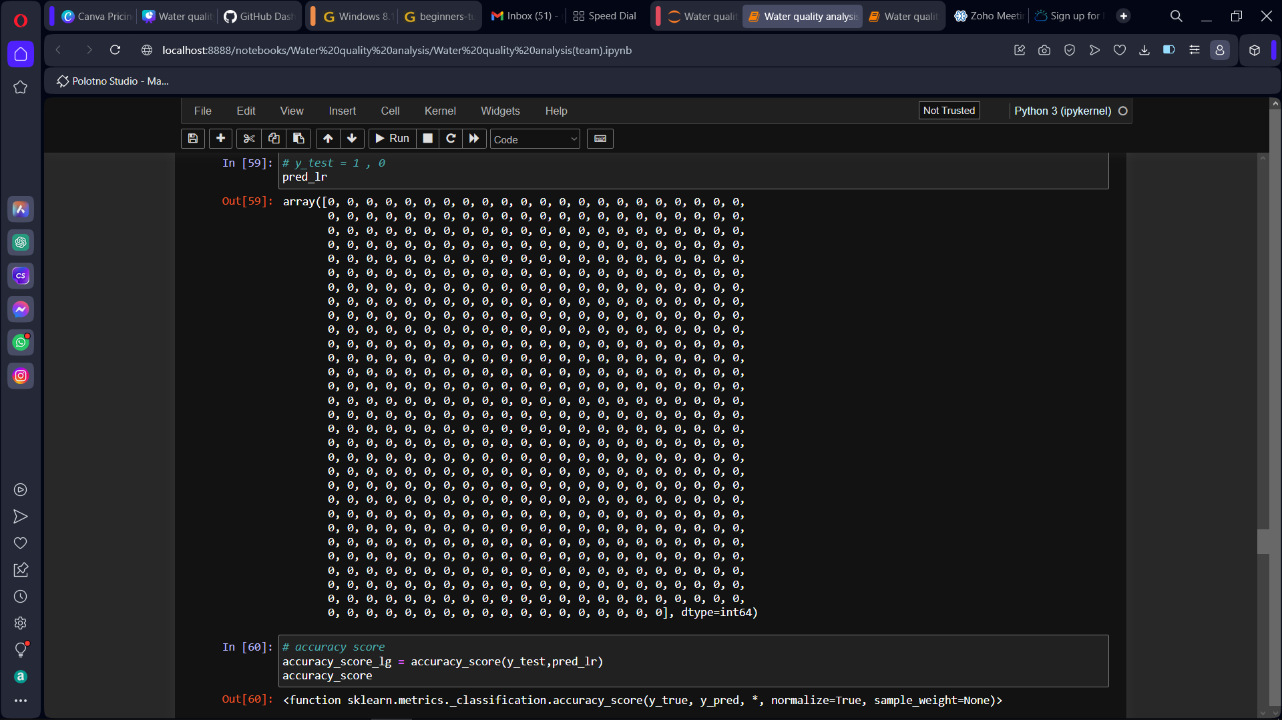

Slide 11
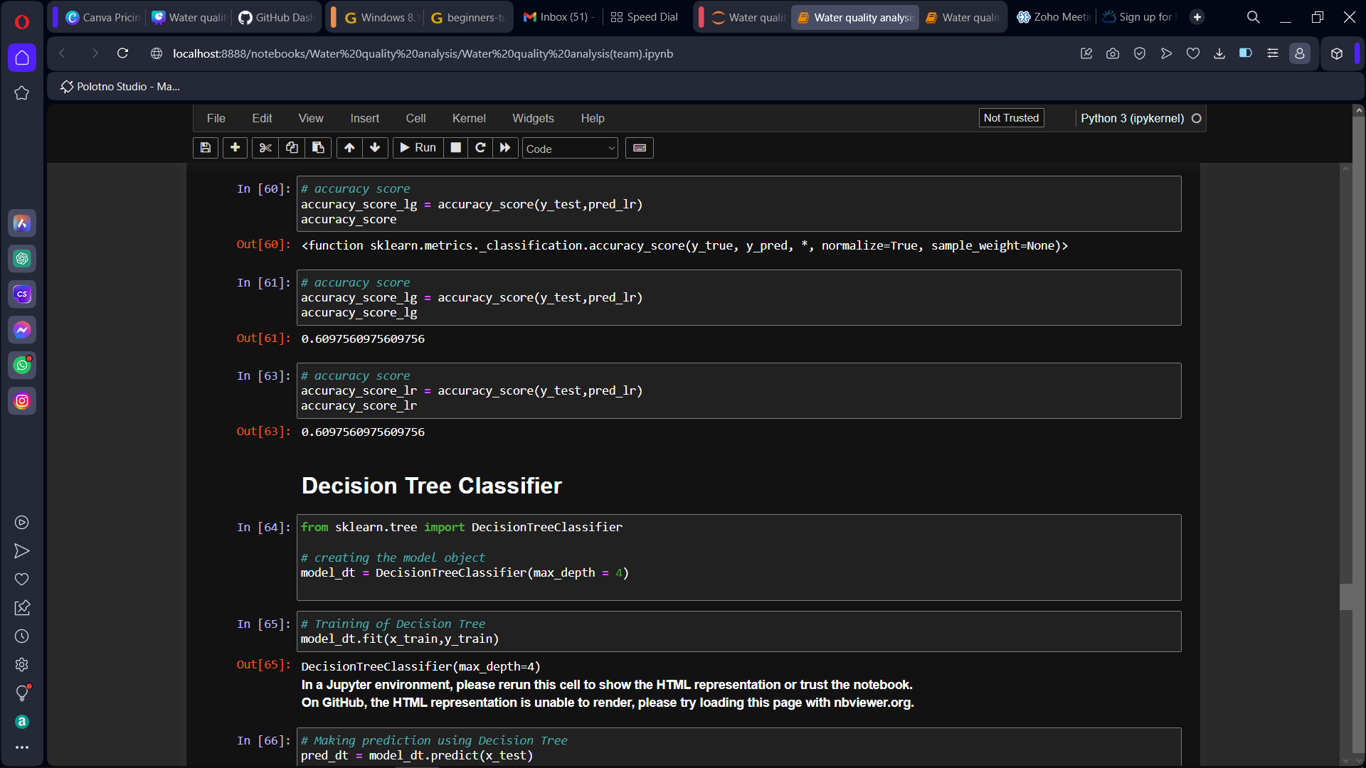

Slide 12
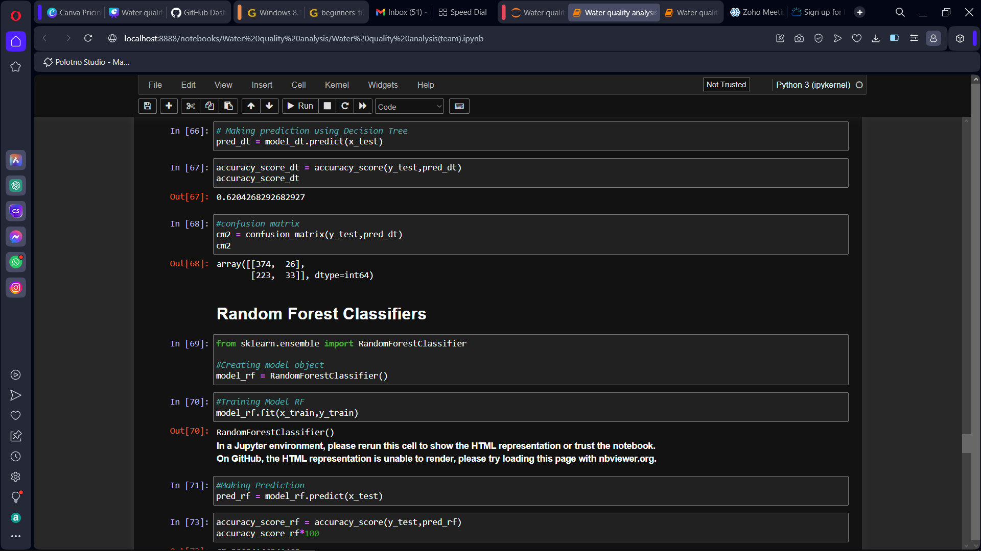

Slide 13
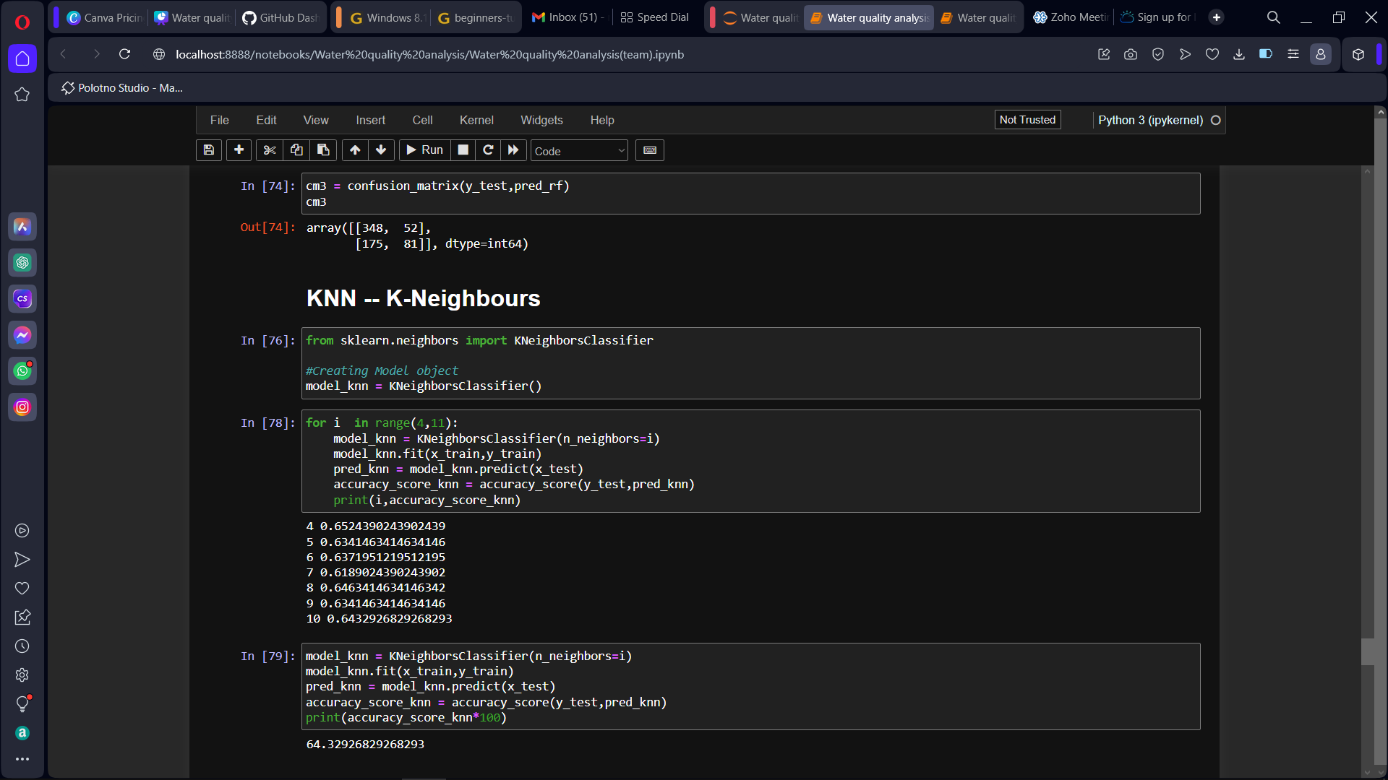

Slide 14
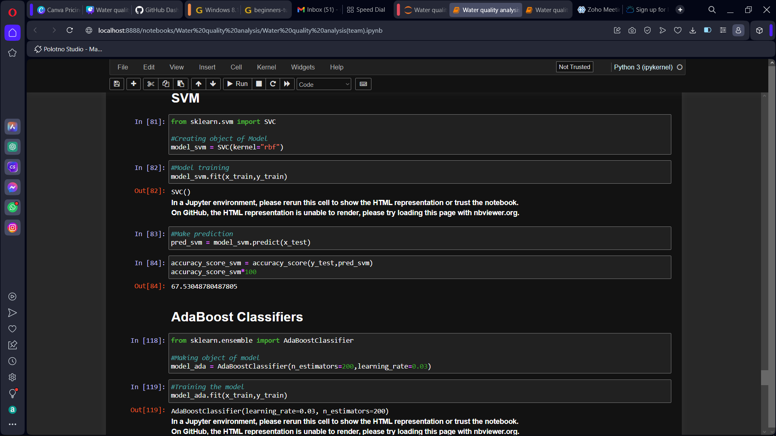

Slide 15
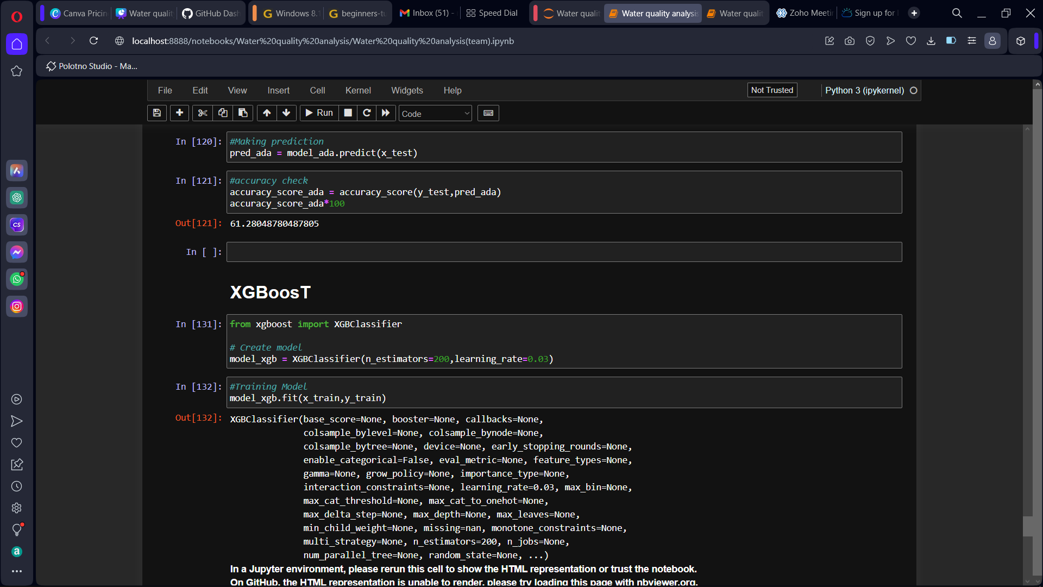

Slide 16
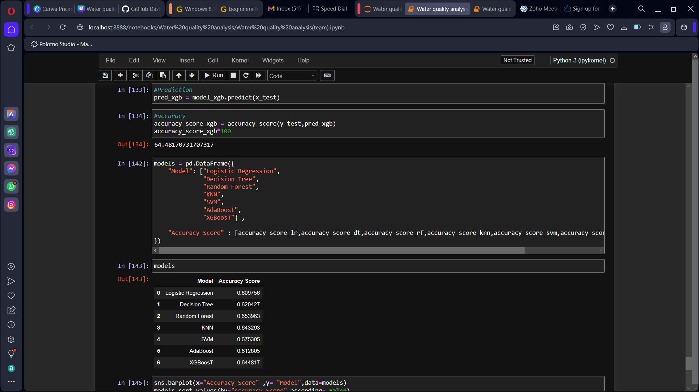

Slide 17

Team members:
Roshan.R
Rishwanth.S
Ashwin.N
Samuel Rithick.R
Maria Fernandez
Roshan.R
i

